Slide 1
PROJECT TITLE
CAPSTONE PROJECT
Presented By:
Male Bindhu Sree - Vignana Bharathi Institute of Technology - Computer Science(Artificial Intelligence and Machine Learning)

Slide 2
OUTLINE
Problem Statement
System Development Approach
Algorithm & Deployment
Result
Conclusion
Future Scope
References

Slide 3
PROBLEM STATEMENT
In today’s fast-changing corporate environment, organizations must adopt fair and data-driven approaches to compensation. With employees coming from varied educational, professional, and socio-economic backgrounds, predicting income categories has become increasingly important. Inaccurate estimations can lead to employee dissatisfaction, higher attrition, and inefficient resource allocation. As workplace diversity grows, identifying hidden patterns in income distribution is crucial. This helps organizations plan better, ensure pay equity, and stay compliant with evolving standards.

Slide 4
SYSTEM APPROACH
This section describes the overall methodology and tools used to build and deploy the employee salary prediction system.
System requirements
Hardware Requirements:
Processor : Intel Core i5 or above
RAM : Minimum 8 GB
Storage : At least 500 MB free disk space
Software Requirements:
OS : Windows / Linux / macOS
Python 3.10+
Streamlit (for frontend deployment)
Git (for version control and deployment)
Library required to build the model
The following Python libraries were used in the project:
pandas – For data loading, cleaning, and manipulation
numpy – For handling missing values and numerical operations
sklearn (scikit-learn) –
LabelEncoder for encoding categorical features
RandomForestClassifier for income category prediction
train_test_split, accuracy_score for model training and evaluation
pickle – To save and load the trained model, encoders, and column data
matplotlib.pyplot – To generate the Actual vs Predicted Salary bar chart
streamlit – To build and run the interactive web app for predictions

Slide 5
ALGORITHM & DEPLOYMENT
Algorithm Selection
Chose Random Forest Classifier due to its robustness with structured and mixed-type data.
Suitable for classification tasks like income prediction.
Data Preprocessing & Input Features
Cleaned data by handling missing values.
Applied Label Encoding for categorical features.
Used features like age, education, occupation, hours-per-week, etc.
Model Training
Split data into training and testing sets.
Trained the Random Forest model.
Saved model, encoders, and feature columns using Pickle.
Deployment with Streamlit
Built a user-friendly Streamlit web app.
Took user inputs and displayed live predictions.
Integrated bar graph for confidence visualization.
Hosting
Deployed app on a cloud platform for public access (e.g., Streamlit Cloud).

Slide 6
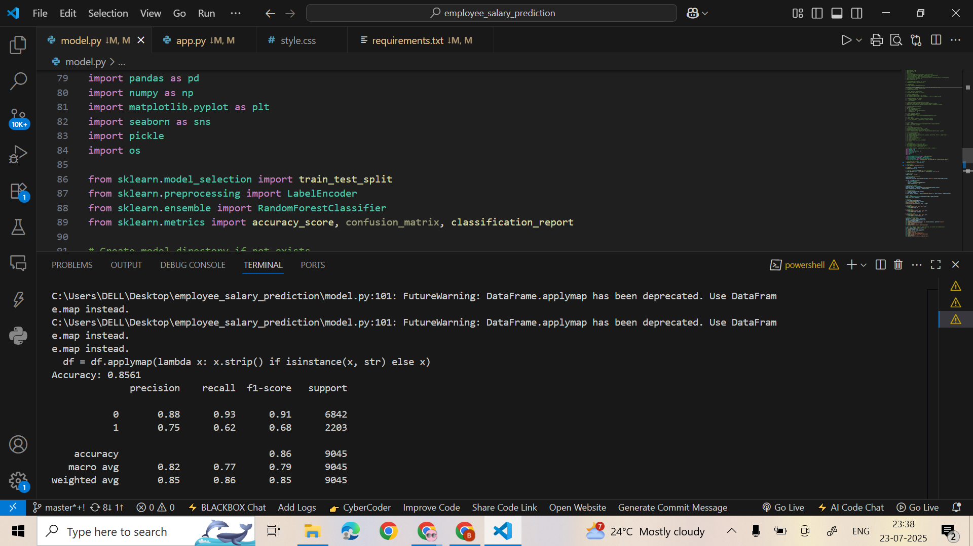
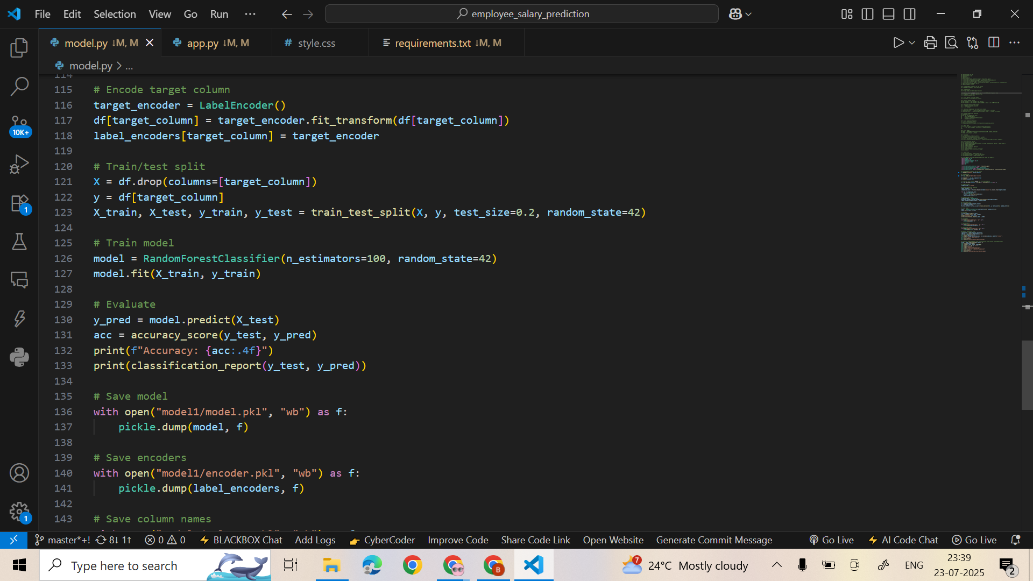
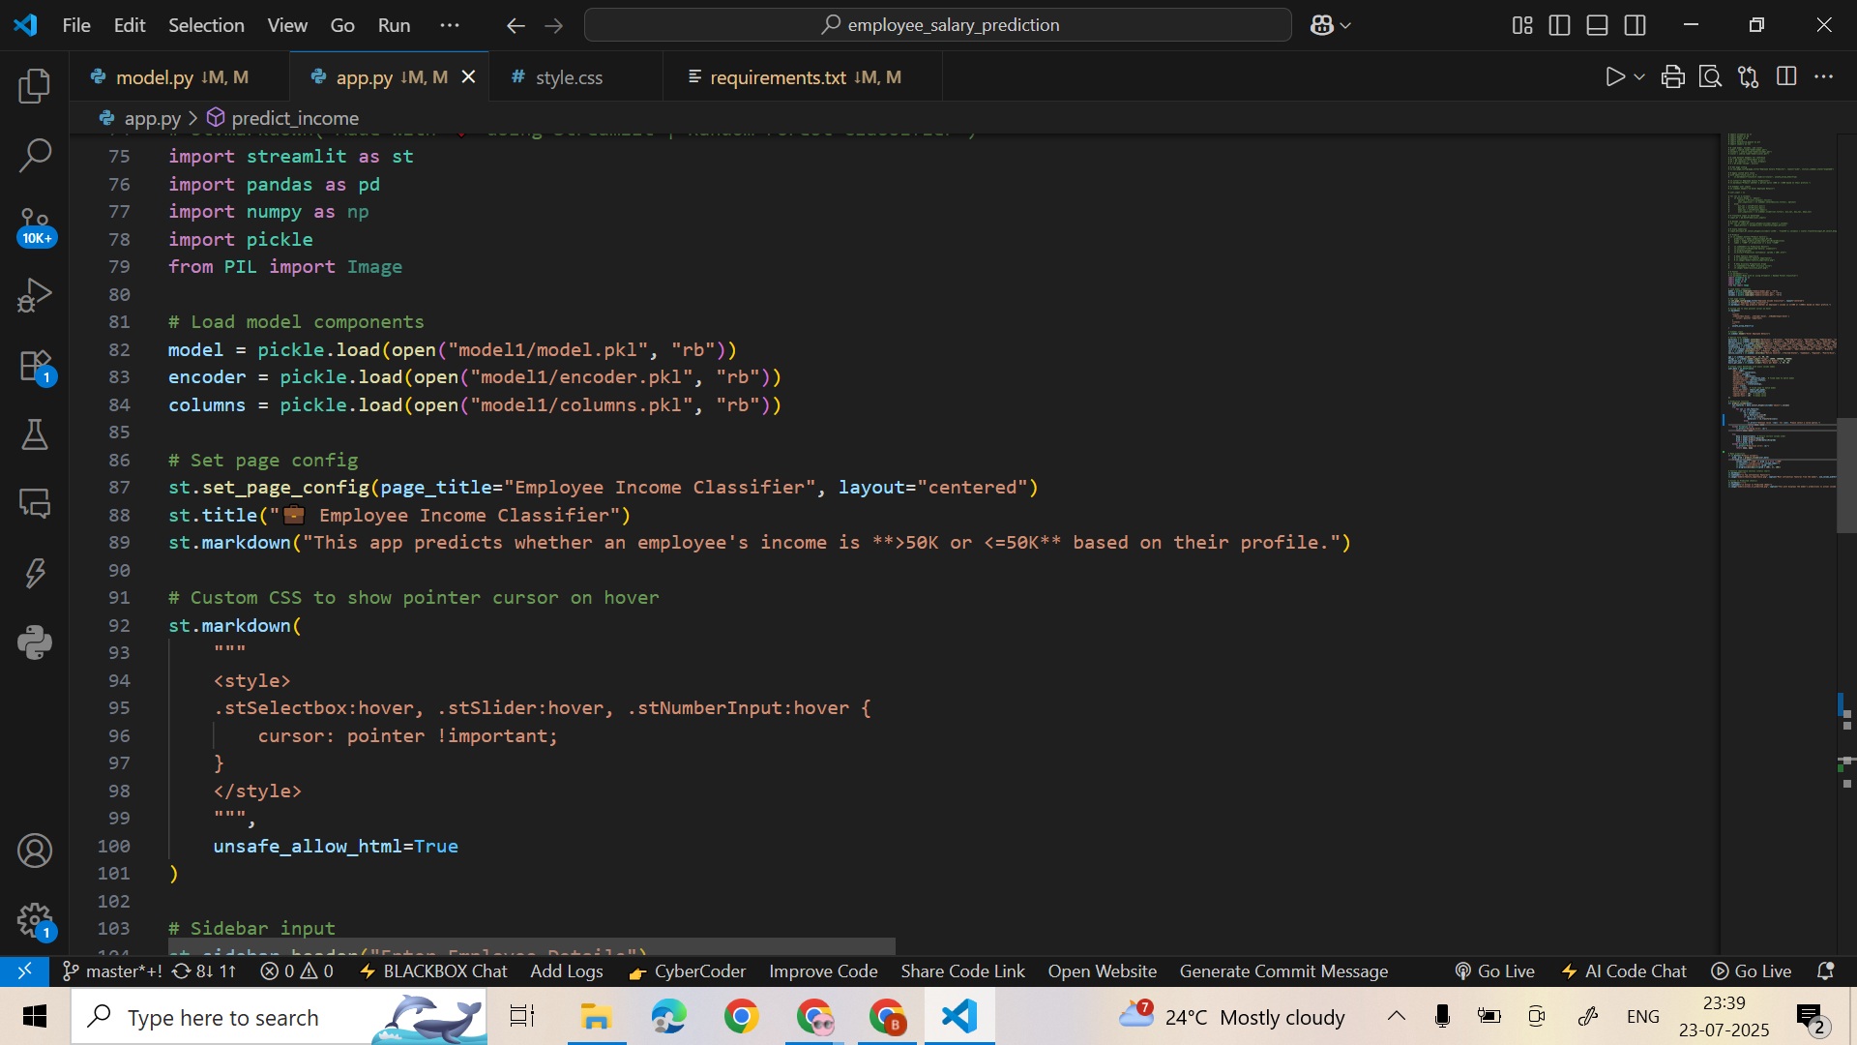
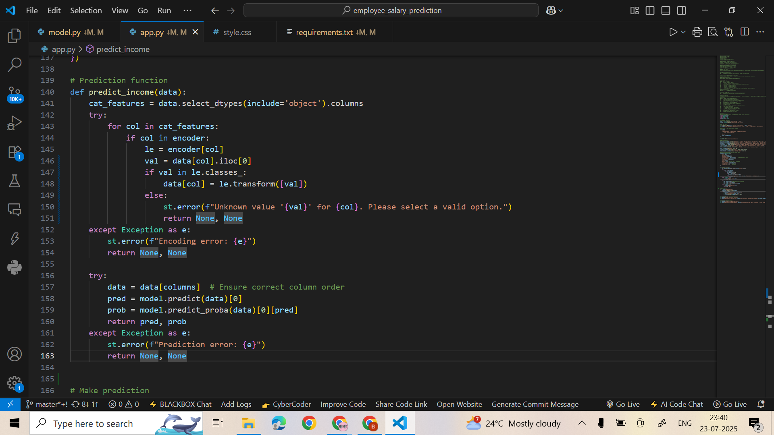
RESULT
Screen snaps of the code and output

Slide 7
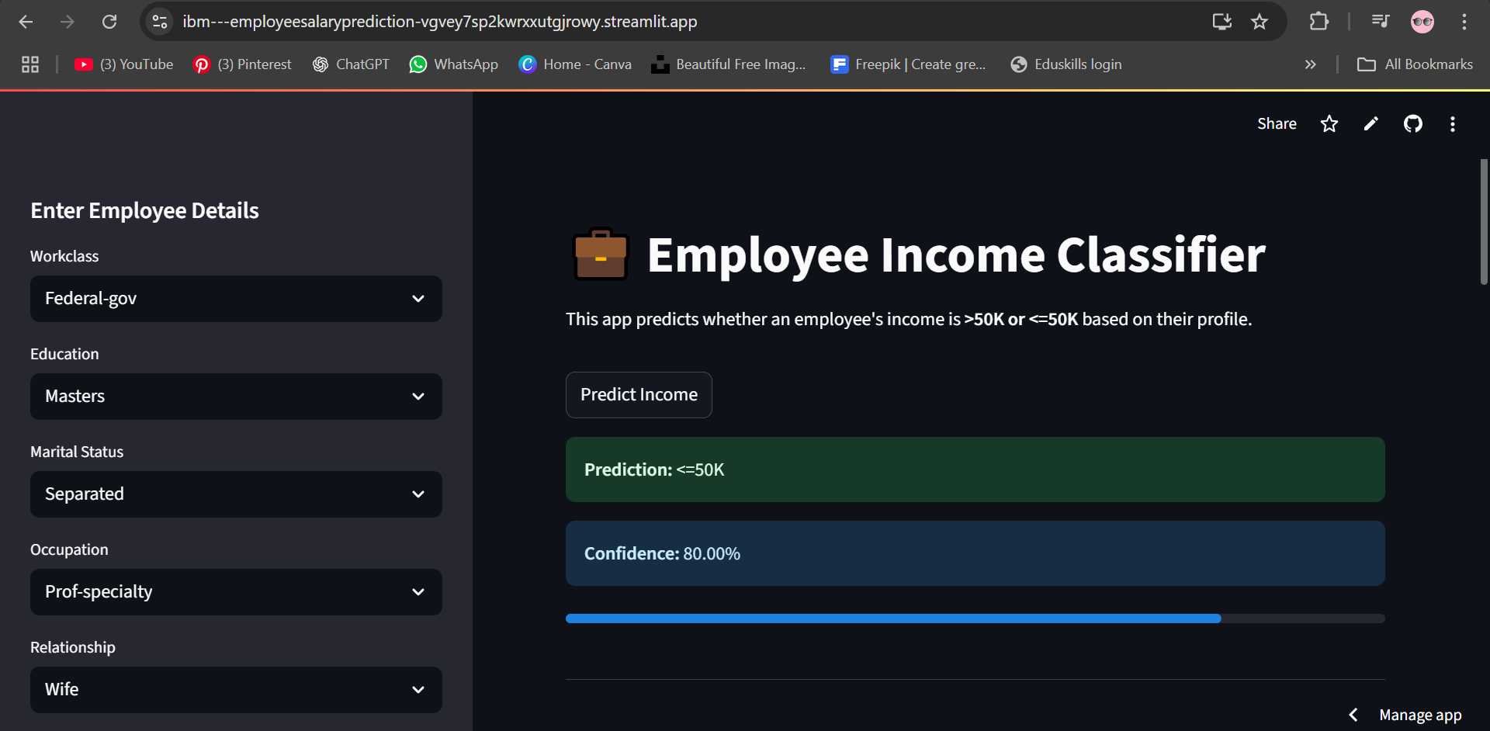
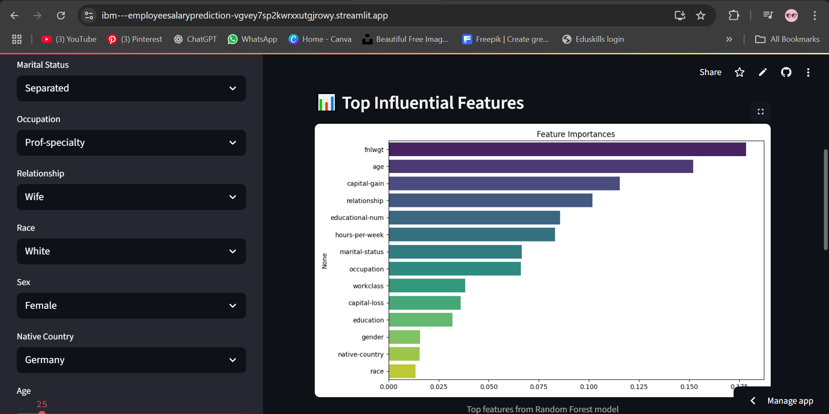
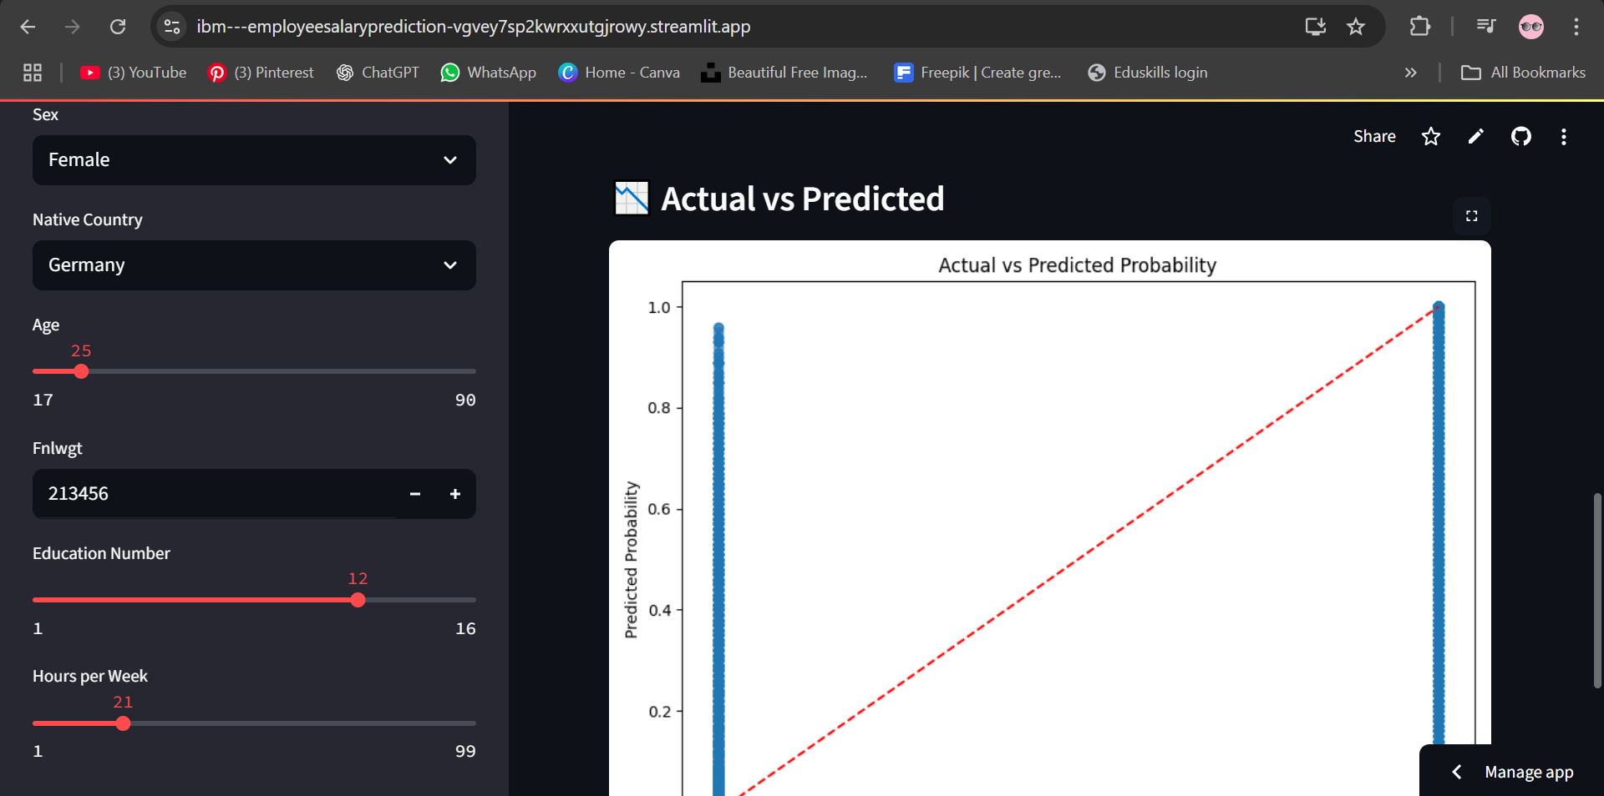
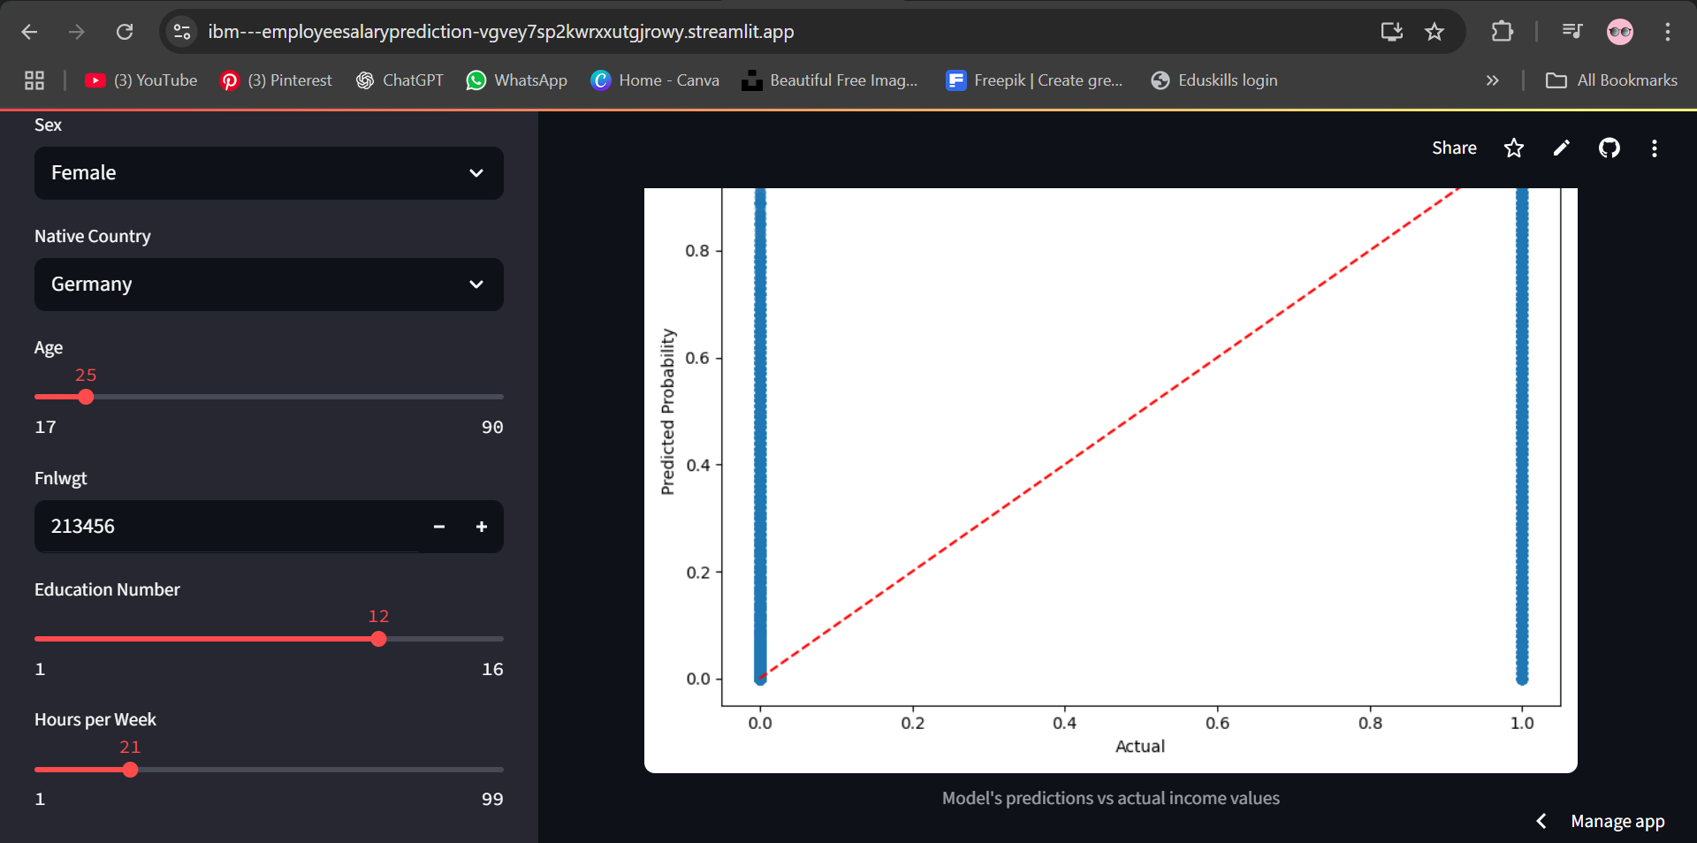
Github link
https://github.com/bindhu0404/IBM---EmployeeSalaryPrediction
Live Demo
https://ibm---employeesalaryprediction-vgvey7sp2kwrxxutgjrowy.streamlit.app/

Slide 8
CONCLUSION
Developed a web-based income prediction system using Random Forest Classifier.
Accurately classifies individuals into income categories based on demographic and work-related inputs.
Achieved reliable performance through proper data preprocessing and feature encoding.
Streamlit app provides a seamless interface with visual confidence feedback for predictions.
Future enhancements include deeper feature insights, expanded datasets, and model comparisons.

Slide 9
FUTURE SCOPE
Integration with Real-time HR Systems Connect the prediction model with live HR databases or enterprise software to auto-fetch employee data and provide instant salary insights at scale.
Explainable AI (XAI) Integration Implement explainability frameworks (like SHAP or LIME) to provide transparent reasons behind each prediction, aiding fairness and trust in compensation decisions.
Bias Detection and Fairness Audits Develop a bias evaluation module to identify and reduce socio-economic or demographic bias in predictions, ensuring ethical AI compliance in hiring or promotion decisions.

Slide 10
REFERENCES
https://www.researchgate.net/publication/371756378_Salary_Prediction_Model_for_Non-Academic_Staff_Using_Polynomial_Regression_Technique
https://www.researchgate.net/publication/371756378_Salary_Prediction_Model_for_Non-Academic_Staff_Using_Polynomial_Regression_Technique
Deisenroth, M. P., Faisal, A. A., & Ong, C. S. (2020). Mathematics for machine learning. UK: Cambridge University Press. https://doi:10.1017/9781108679930
Brownlee, J. (2023). A tour of machine learning algorithms. Retrieved from: https://machinelearningmastery.com/a-tourof-machine-learning-algorithms
Benner, J. (2020). Cross-validation and hyperparameter tuning: How to optimise your machine learning model. Retrieved from: https://towardsdatascience.com/cross-validationand-hyperparametertuning-how-to-optimise-your-machine-learning-model13f005af9d7d

Slide 11
THANK YOU

